Slide 1

Columbia Asia Hospital Project
HARSH BHATIA
02/01/2024

Slide 2

INTRODUCTION
Columbia Asia Hospitals, founded in 1996, is a multinational healthcare chain operating in India, Malaysia, Vietnam, and Indonesia.
The hospitals focus on delivering patient-centered care through state-of-the-art infrastructure, advanced medical technology, and a team of skilled medical professionals.
Their facilities typically offer a range of services, including general surgery, cardiology, orthopedics, neurology, pediatrics, and obstetrics.
With advanced technology and skilled professionals, they prioritize patient-centered care and accessibility through strategically located facilities.

Slide 3

Problem Statement
Revenue Assessment:
Conduct a detailed analysis of revenue generation mechanisms.
Identify strengths and areas for optimization to enhance financial performance.
Staffing Optimization:
Evaluate departmental staffing needs to determine areas requiring additional hires.
Ensure resource allocation aligns with the goal of delivering high-quality patient care.
Patient Discount Strategy:
Develop data-driven strategies for implementing patient discounts.
Balance financial sustainability with increased accessibility to healthcare services.

Slide 4
DATA OVERVIEW
Date: This column contains date and time information without specifying AM or PM. The format is DD-MM-YYYY HH:MM.
Patient ID: Each patient is assigned a unique identifier, which seems to be in the format 124-62-3289.
Patient Gender: This column records the gender of the patient, denoted by 'M' for male and 'F' for female.
Patient Age: The age of the patients is listed in years.
Patient Sat Score: It seems to represent a satisfaction score given by or for the patient. However, the scores are single-digit, and it's not clear what the scale is.
Patient First Initial: This column contains the first initial of the patient's first name.
Patient Last Name: The surname of the patient is listed in this column.

Slide 5
DATA OVERVIEW
Patient Race: The racial or ethnic background of the patient is recorded here, with categories such as 'White', 'African American', 'Asian', 'Native American/Alaska Native', and 'Two or More Races’.
Patient Admin Flag: This column contains Boolean values ('TRUE' or 'FALSE') which might indicate whether the patient was admitted or some other administrative flag.
Patient Wait Time: Appears to indicate the time the patient waited, possibly in minutes, before being seen or processed.
Department Referral: This column lists the department to which the patient was referred, with entries such as 'General Practice', 'Orthopaedics', 'Gastroenterology', or 'None' indicating no referral.
Doctor Name: Identifies the doctor who attended each patient.
Appointment Fees: The cost charged for a doctor's consultation.
Total Bill: The overall amount billed to the patient, including all services and charges.

Slide 6

METHODOLOGY
Data Cleaning:
Handling missing values: In the column “patient sat score”, the null values were replaced with 0 to avoid errors during analysis.
Data transformation:
Date and Time were extracted into separate columns from the Date column.
“Patient Name” column was created by merging both first name initial column and last name column for the efficiency.
“Gender” column was created in which the gender name was written from the abbreviations.

Slide 7
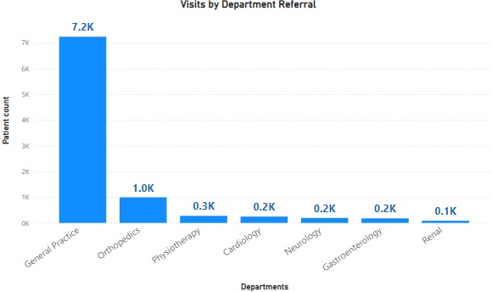
Patient visits by Department Referral
Insights:
“General Practice“ department has the most patient visits.
“Renal” department has the least patient visits.

Slide 8
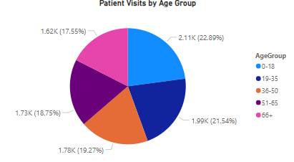
Patient demographics by Age group
Insights:
Most patients are from “0-18” age group, around (2.11K) patients accounting (22.89%) of the total patients.
Followed by patients from “19-35” and “36-50” age group.
Least patients are from “66+” age group, around (1.62K) patients.

Slide 9
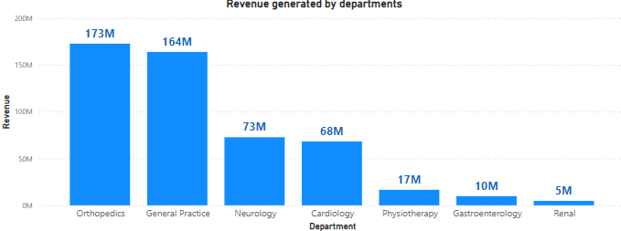
Revenue generated by each department
Insights:
“Orthopedics” department generated the most revenue i.e., (173M).
Followed by “General Practice”, “Neurology” and “Cardiology”.
“Renal” department generates the least revenue i.e., (5M).

Slide 10
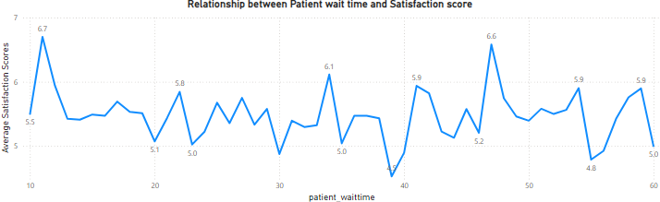
Relationship between Patient wait time and Satisfaction Score
Insights:
The satisfaction score is mostly uniform during the period of wait time but highest satisfactory score is obtained during the 10 mins wait time (6.70) and lowest around 40 mins (4.53).
The ratings might not be accurate as 75% of the ratings were missing and analysis has been made on the basis of remaining 25%, so the hospital should also encourage patients to provide the ratings so that the accurate analysis can be made.

Slide 11
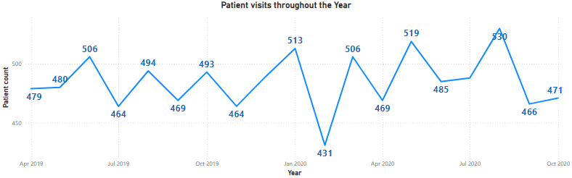
Patient visits throughout the Year
Insights:
Patients visits peaked on August 2020 (530).
Least number of patients visited on February 2020 (431).

Slide 12
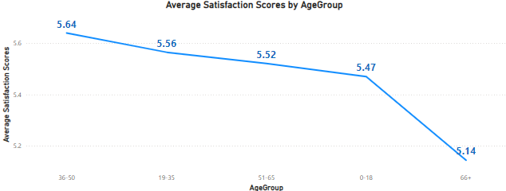
Average Satisfaction Scores by Age group
Insights:
Age group 36-50 reports the highest satisfaction score (5.64).
Age group 66+ reports the lowest ratings (5.14).

Slide 13
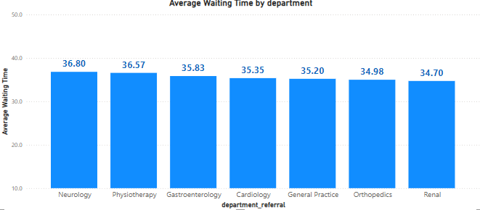
Average waiting time for each department
Insights:
“Neurology” department had the highest average waiting time of (36.80) minutes.
“Renal” department had the lowest average waiting time of (34.70) minutes.
There is no significant difference between the waiting time of all the departments as the average waiting time in all departments is around (35.63) minutes.

Slide 14
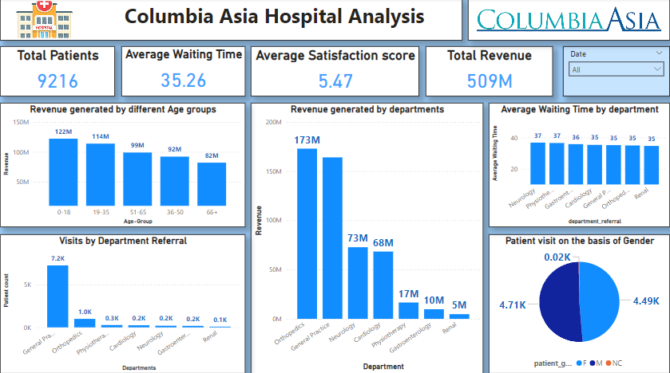
Main Tab

Slide 15
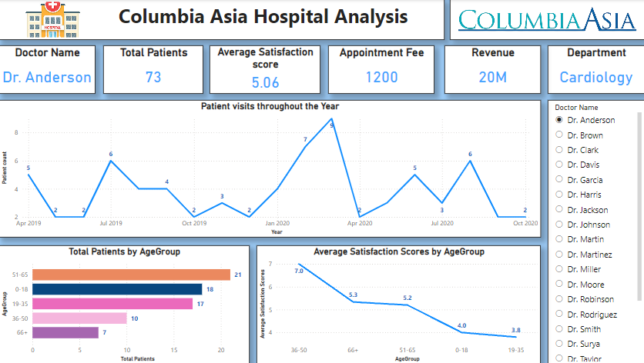
Doctor Tab

Slide 16
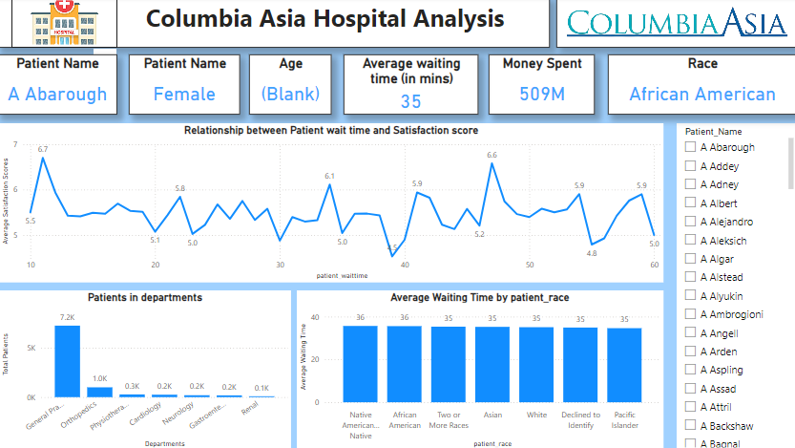
Patient Tab

Slide 17

Recommendation
Staff Allocation:
Allocating new doctors in the departments with high patient visits would help in attending more patients and will help in reducing the wait time of patients.
General Practice department should be provided with more doctors as there are most patient visits.
Patient Satisfaction Score:
Reducing waiting time and providing discounts to patients will help in increasing the satisfaction score and will also help in boosting hospital reputation.
Patient Feedback:
Patient feedback should be the priority, as around 75% of the patients have not provided the satisfaction score.
So the patients should be encouraged to provide the feedback so that the appropriate actions could be taken.

Slide 18
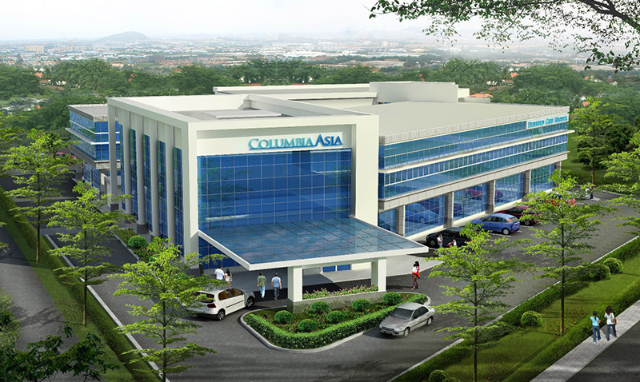
Conclusion
Key Insights Identified:
The analysis highlighted vital trends, including department-wise revenue generation, patient demographics, and satisfaction scores, aiding in targeted strategic decisions.
Actionable Recommendations:
Suggestions like optimizing staff allocation, encouraging patient feedback, and improving wait times aim to enhance operational efficiency and patient satisfaction.
Strategic Path Forward: The insights lay the foundation for implementing data-driven policies, balancing financial sustainability with improved healthcare accessibility.

